Slide 1
Python Language & Features

Slide 2
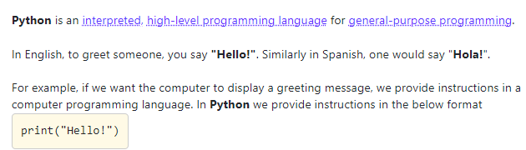
What is Python?

Slide 3
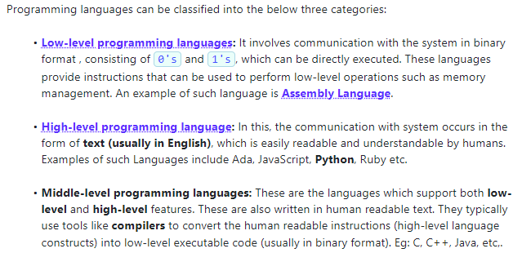

Slide 4
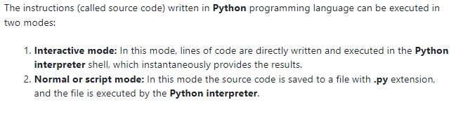
Modes of Instruction

Slide 5
Errors in Python
1. SYNTAX ERROR
2. RUN TIME ERROR

Slide 6
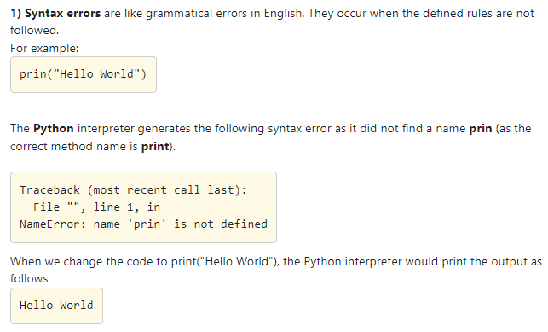
SYNTAX ERRORS

Slide 7
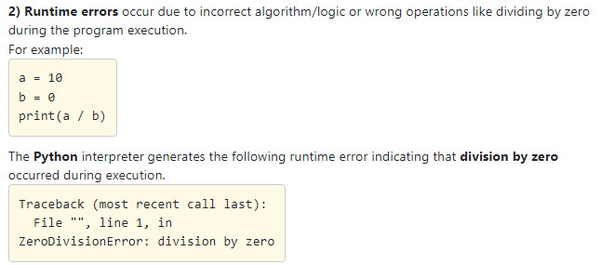
RUNTIME ERRORS

Slide 8
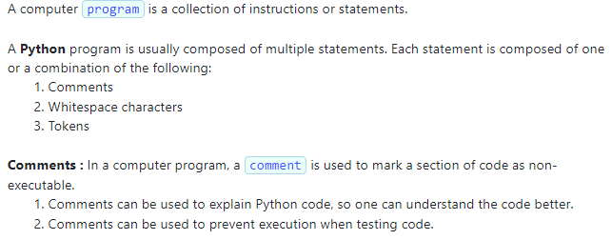
About Python Program

Slide 9
Types of Comments
1. Single Line Comments
2. Docstring Comments

Slide 10
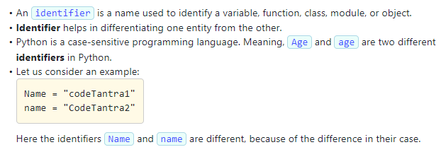
Identifiers in Python

Slide 11
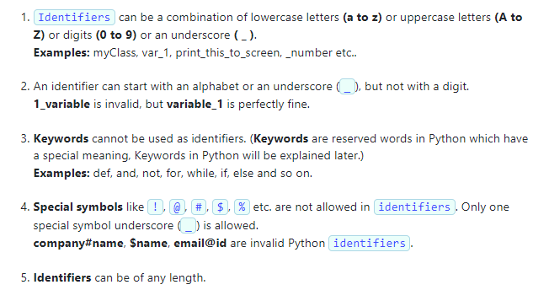
RULES FOR IDENTIFIERS

Slide 12
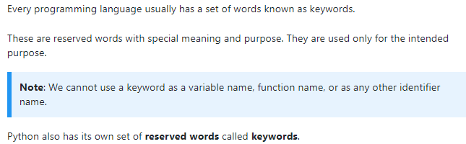
KEYWORDS

Slide 13
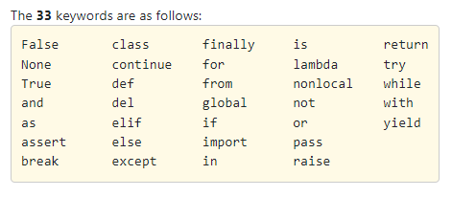
Various Keywords in Python

Slide 14
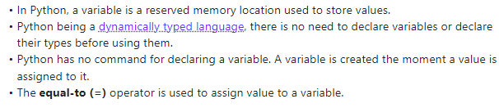
VARIABLES

Slide 15
Chained Assignment

Slide 16
Operators

Slide 17
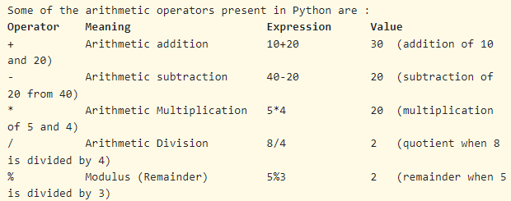
Operators in Python

Slide 18
Assignment statements in Python
Basic Assignment statements
Augmented Assignment statements

Slide 19
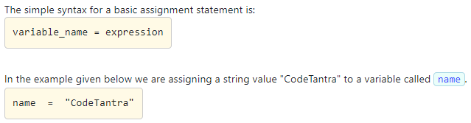
Basic Assignment Statement

Slide 20
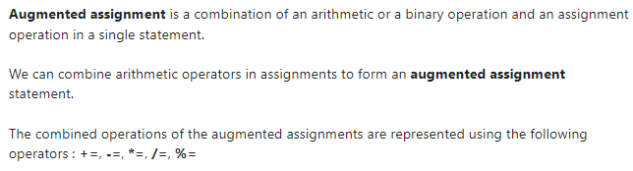
Augmented Assignment Statement

Slide 21
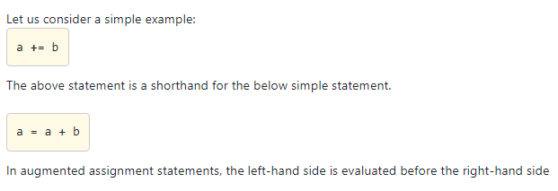
Contd…

Slide 22
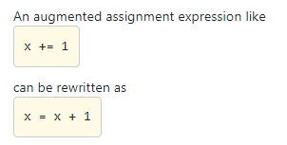
Example:

Slide 23
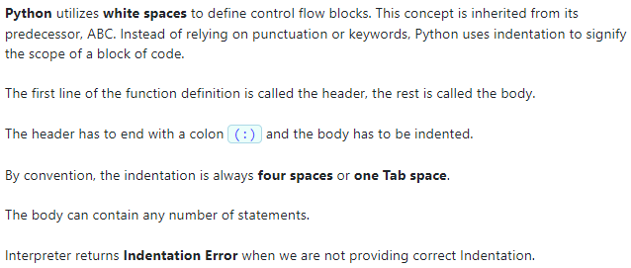
INDENTATION IN PYTHON

Slide 24
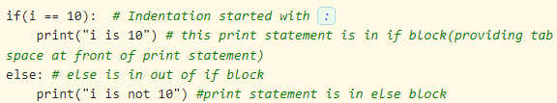
Example:

Slide 25
Data Types in Python
Data types categorize data for efficient processing in Python and all programming languages.
They assign specific characteristics to data, enhancing accuracy and control in operations.

Slide 26
The data type of the data determines :
possible values it can be assigned.
possible operations that can be performed. (Arithmetic operations can be applied on numeric data and not strings)
the format in which it is stored in the memory.
the amount of memory allocated to store the data.

Slide 27
Some of the built-in data types supported in Python are:-
Number
String
List
Tuple
Set
Dictionary

Slide 28
Contd….
The same variable in Python can refer to data of different data types at different times.
Thus, variables in Python are not strongly typed, implying that you don't have to explicitly declare the data type of a variable when creating it.

Slide 29

Example:

Slide 30
Numbers
There are 3 different categories of Numbers in Python.
Int
Float
Complex

Slide 31
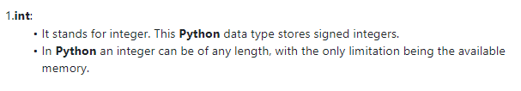
Int:

Slide 32
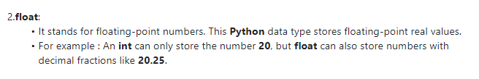
Float:

Slide 33

Complex:

Slide 34
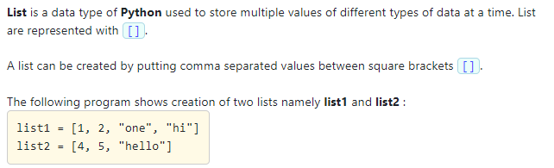
List

Slide 35
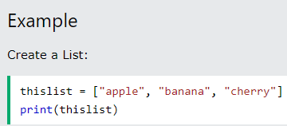

Slide 36
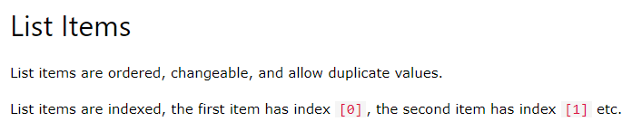

Slide 37
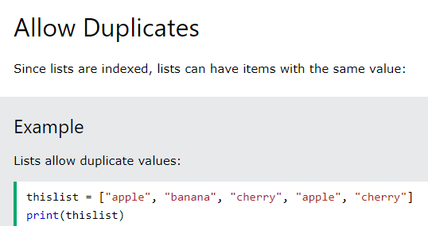

Slide 38
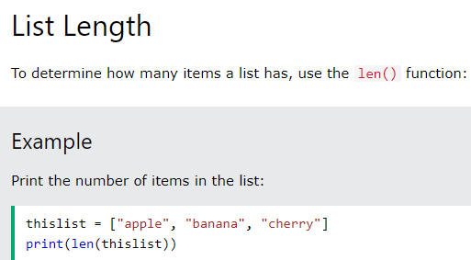

Slide 39
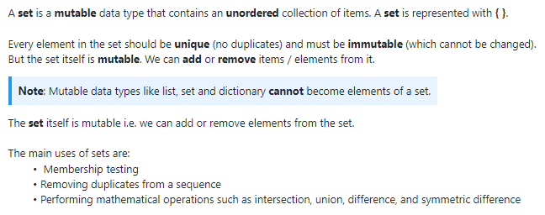
Sets in Python

Slide 40
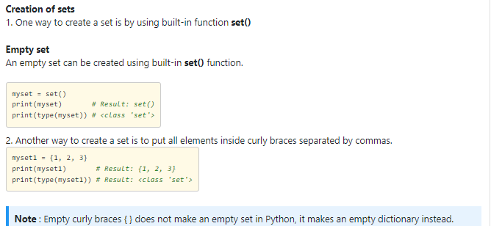
Contd…

Slide 41
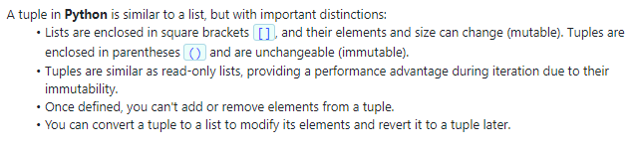
Tuple

Slide 42
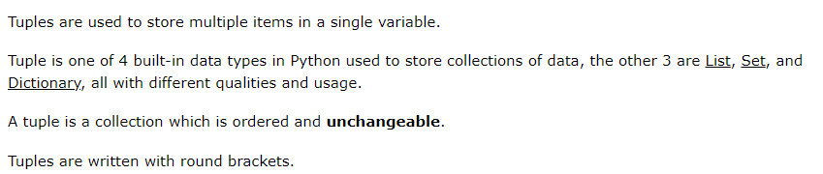

Slide 43
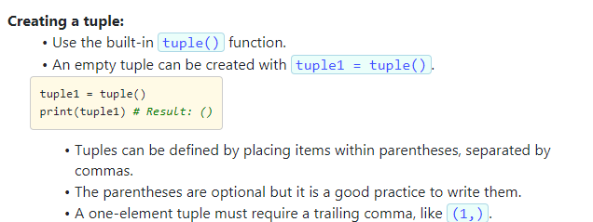

Slide 44
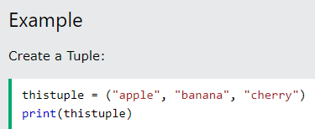

Slide 45
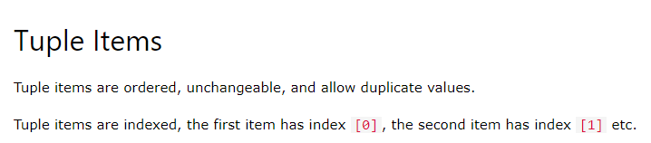

Slide 46
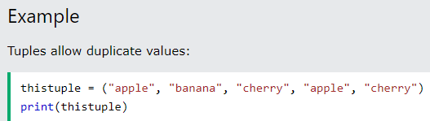
Allows duplicate values:

Slide 47
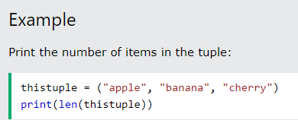
To find Tuple length:

Slide 48
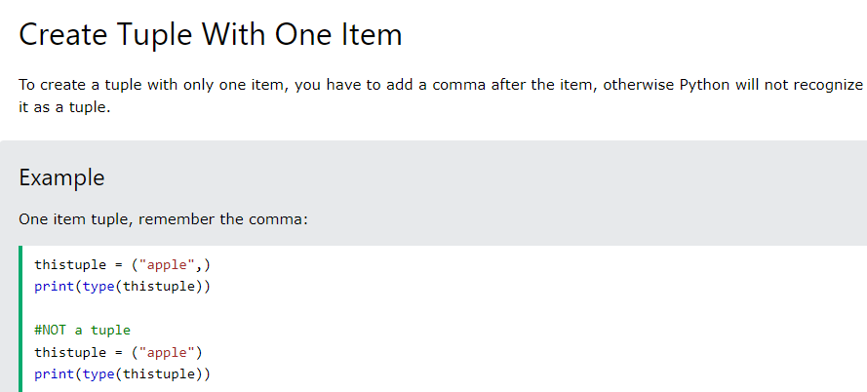

Slide 49
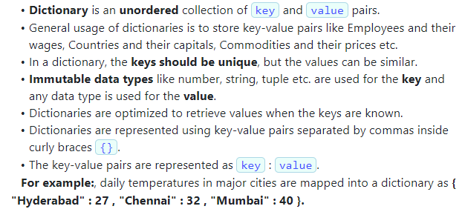
Dictionary

Slide 50
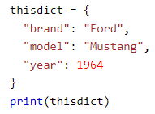
Example:

Slide 51
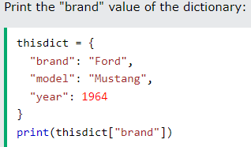
Example:

Slide 52
thisdict = { "brand": "Ford", "model": "Mustang", "year": 1964 } print(thisdict["brand"])

Slide 53
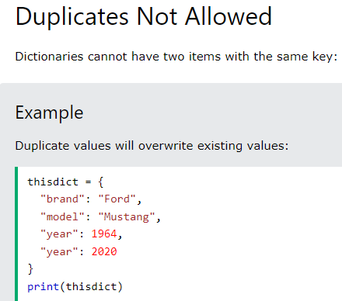

Slide 54
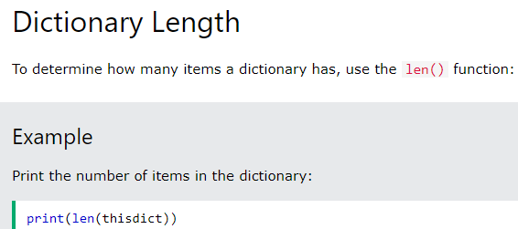

Slide 55
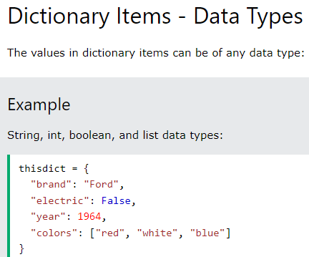

Slide 56

Input and Output Statements

Slide 57
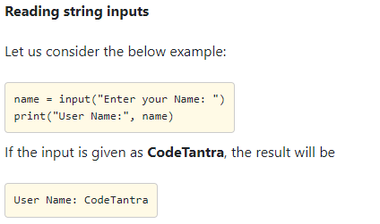

Slide 58
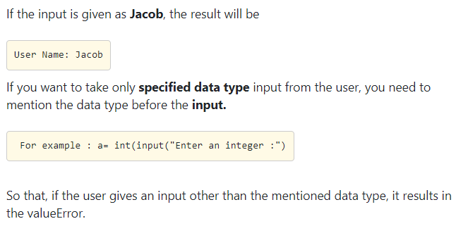

Slide 59

Example:

Slide 60
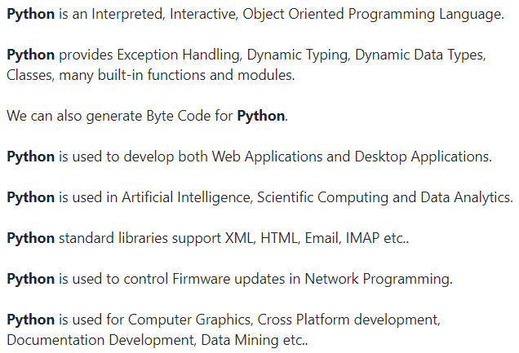
Basics of Python Programming

Slide 61
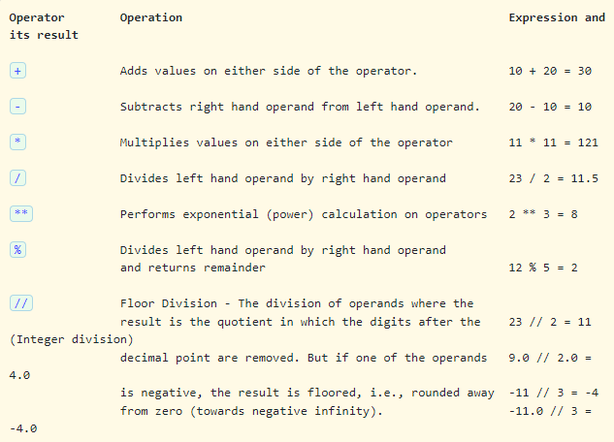
Arithmetic Operators

Slide 62
Python Booleans :
Booleans represent one of two values: True or False.

Slide 63

You can evaluate any expression in Python, and get one of two answers, True or False.

Slide 64
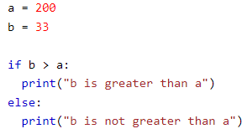
Print a message based on whether the condition is True or False:

Slide 65
Evaluate Values and Variables
The bool() function allows you to evaluate any value, and give you True or False in return.

Slide 66

Evaluate a string and a number:

Slide 67
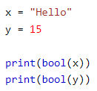
Evaluate two variables:

Slide 68
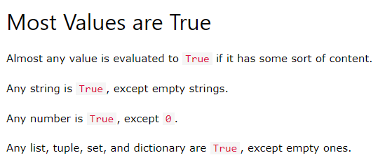
Contd…

Slide 69
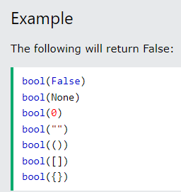
Some Values are False

Slide 70
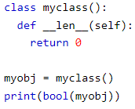
Contd…. if you have an object that is made from a class with a __len__ function that returns 0 or False:

Slide 71

Functions can Return a Boolean

Slide 72
You can execute code based on the Boolean answer of a function

Slide 73

Print "YES!" if the function returns True, otherwise print "NO!"

Slide 74
Data Type Conversion
The act of changing an object’s data type is known as type conversion.

Slide 75

Data Type Conversion

Slide 76

Example:

Slide 77

Identity Operator

Slide 78


Slide 79


Slide 80


Slide 81


Slide 82

Note:

Slide 83


Example:

Slide 84

Contd….

Slide 85

Operator precedence

Slide 86

Contd…

Slide 87

Operator precedence

Slide 88

Contd…

Slide 89

Question

Slide 90

Contd… (Note: - instead of 82.0, use 32.0 in below written code)

Slide 91

Contd…

Slide 92


For loop example:

Slide 93

If else example: Python program to calculate the sum of numbers from 1 to a user-defined positive integer using If else.

Slide 94

Contd…. Output:-

Slide 95

Logical Operator

Slide 96

Contd…

Slide 97

Contd…

Slide 98

Contd… Syntax for If-else statement:

Slide 99

Contd… Example:

Slide 100

Problem statement

Slide 101

Contd…

Slide 102

Contd… Solution:

Slide 103

Problem statement

Slide 104

Contd… Solution:

Slide 105

Problem statement

Slide 106

Contd…

Slide 107

Solution:

Slide 108

Logical Not

Slide 109

Contd…

